Slide 1
Study of Earthquake Activity in North America, South America, and Pacific Ocean
by Kyle Shimberg, Yawavi Koudjonou, Saiana Darizhapova

Slide 2
Agenda
Background - Saiana
Analysis - Kyle
Conclusion - Yawavi

Slide 3
Questions
Have Earthquakes increased in Magnitude since 1990?
Are Earthquakes occurring more frequently since 1990?
Where are Earthquakes most likely to occur?

Slide 4
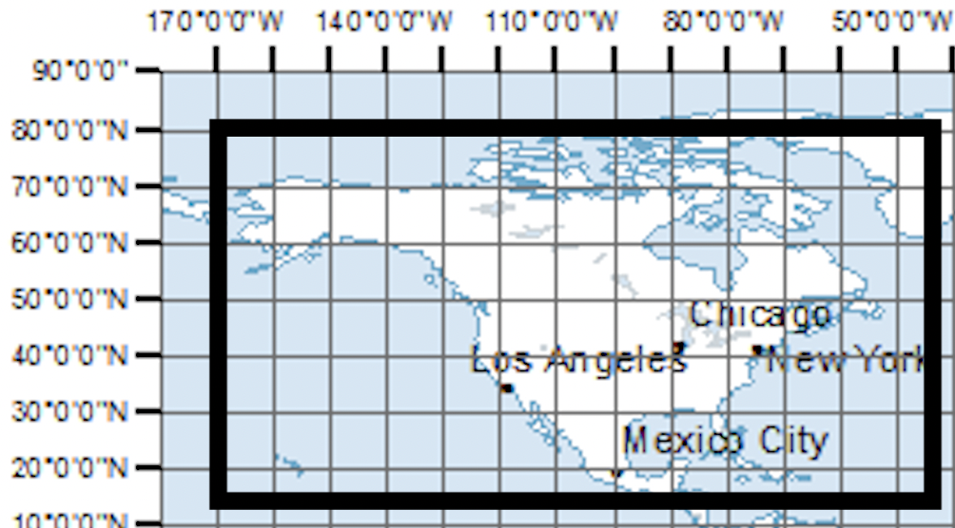
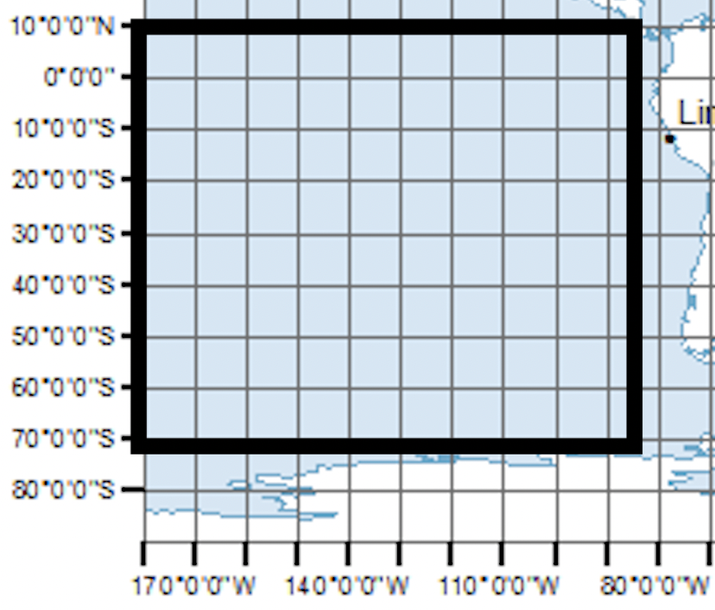
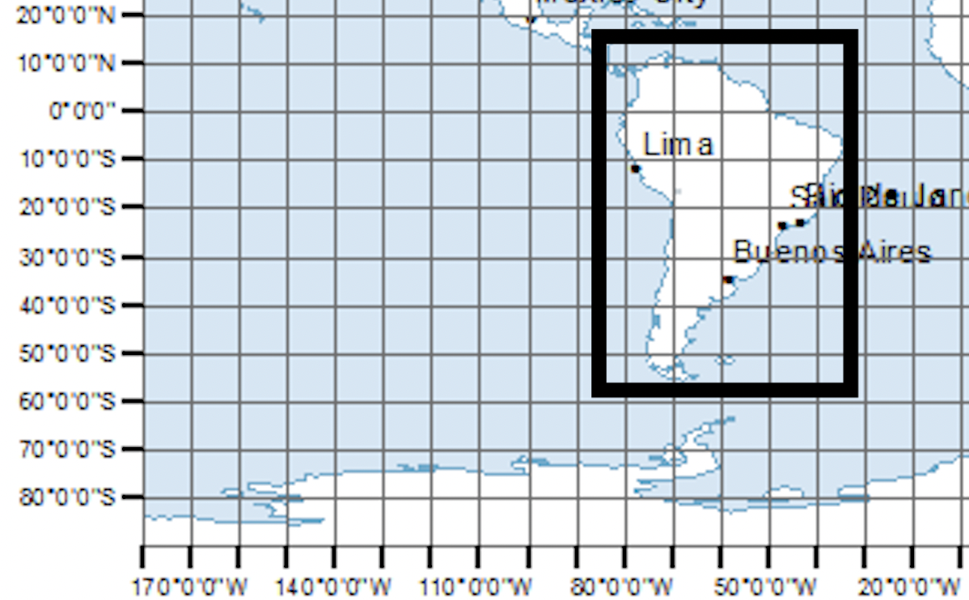
Regions
North America
Pacific Ocean
South America
Notes:
We broke out our desired region of research into 3 distinct areas so that we would be able to pull the Earthquake data from the API in batches. These regions were North America, South America, and the Southern Pacific Ocean.

Slide 5
Earthquake Severity
Magnitude | Description | Effects | Occurrences 1990-2021
5-5.9 | Moderate | Slight Damage Chance | 13,299
6-6.9 | Strong | Moderate Damage Chance | 1271
7-7.9 | Major | Great Damage Chance | 115
8+ | Great | Major Damage or Destruction | 14
Notes:
We chose to track Earthquakes that were Magnitude 5 or greater. This is because earthquakes begin to be felt by all at Magnitude 5 and this is also where damage begins to occur.

Slide 6
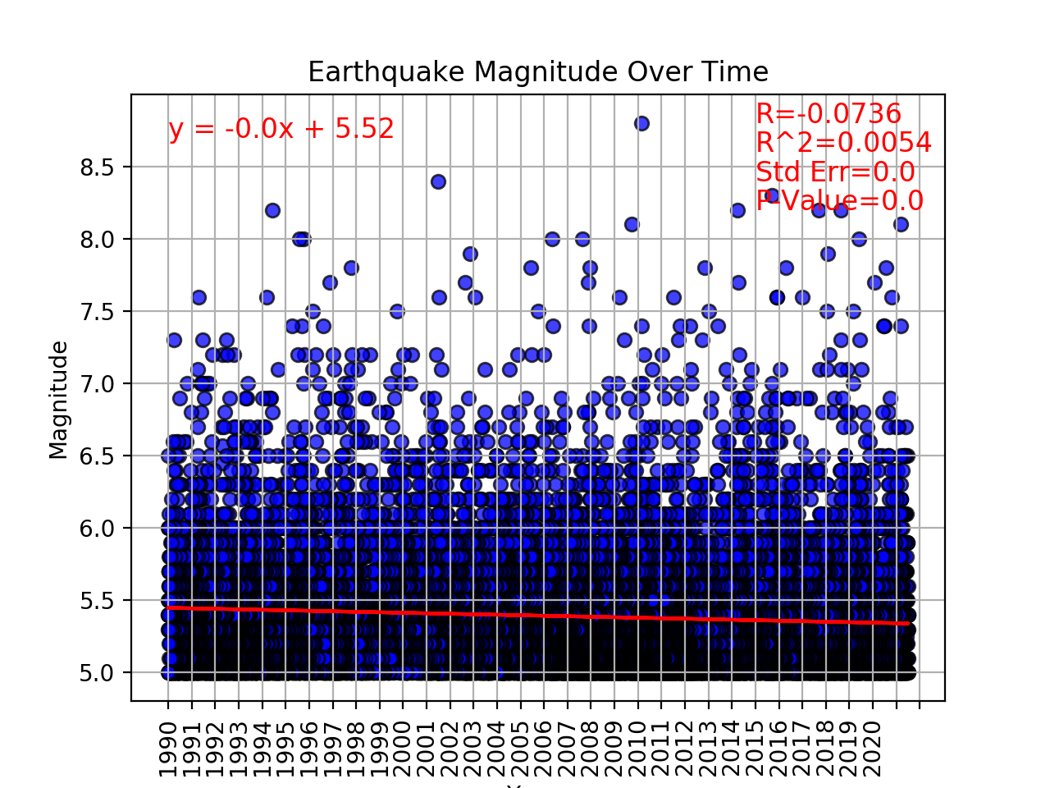
5.0 and Greater

Slide 7
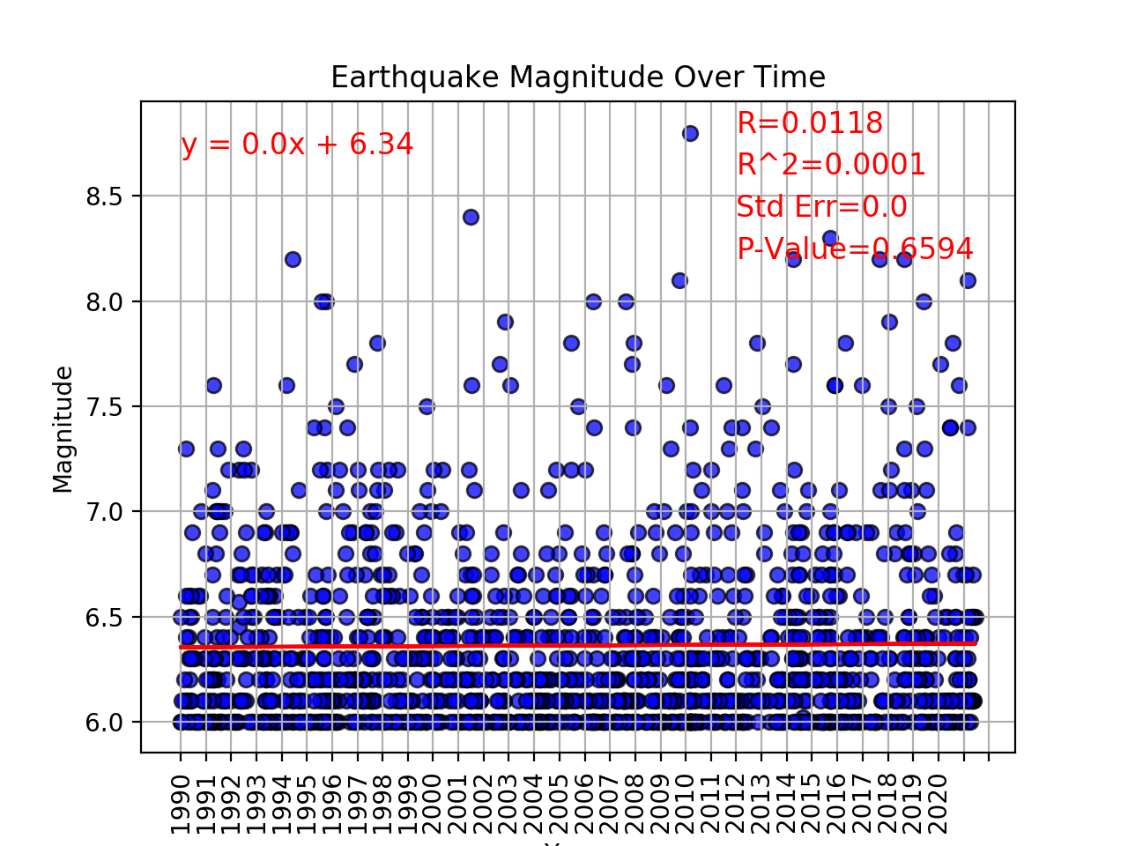
6.0 and Greater

Slide 8
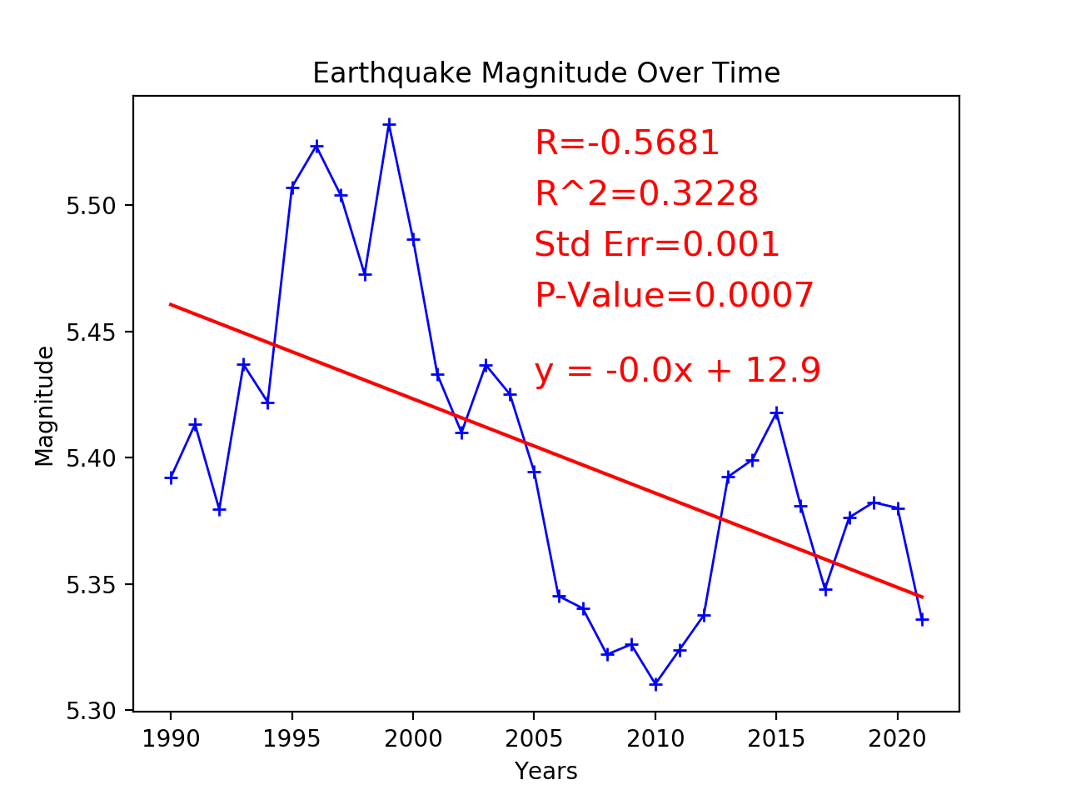
5.0 and Greater

Slide 9
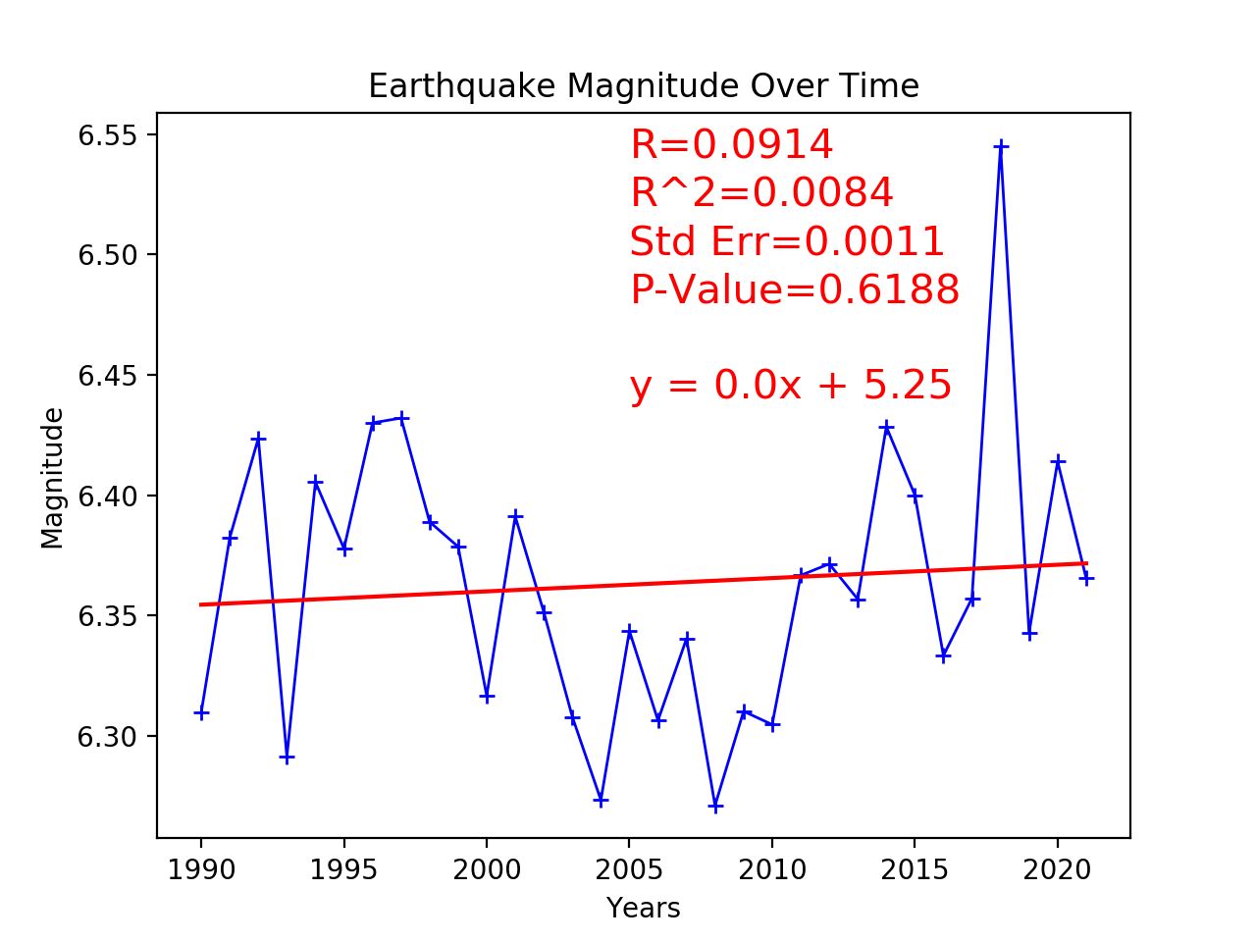
6.0 and Greater

Slide 10
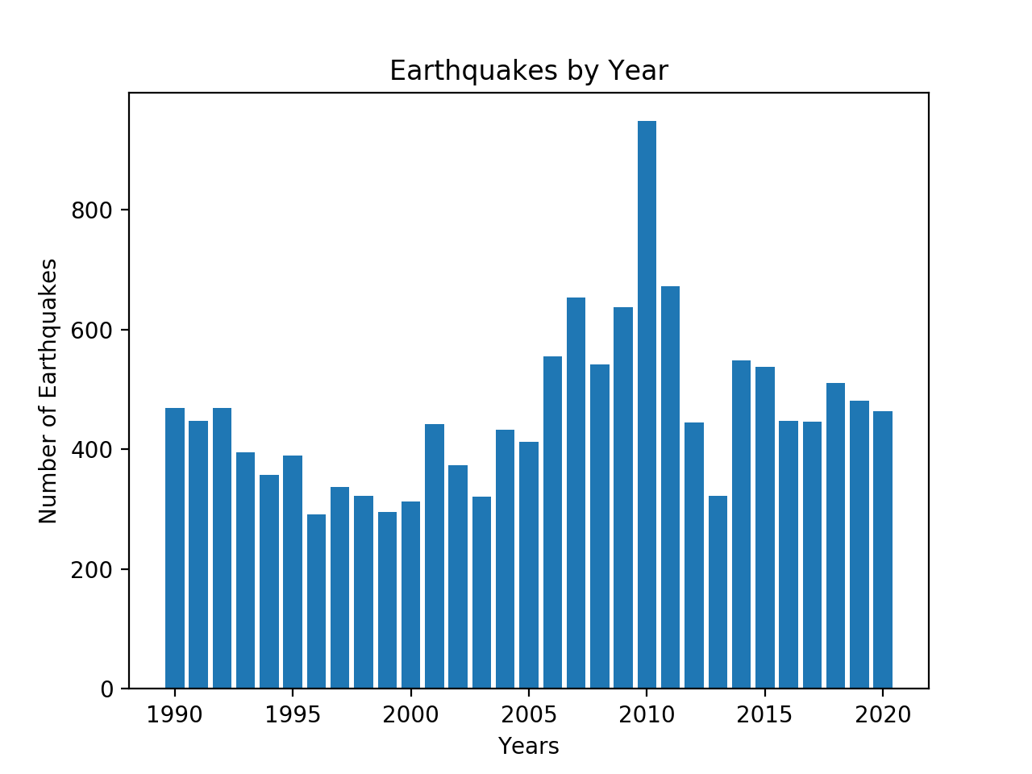
5.0 and Greater

Slide 11
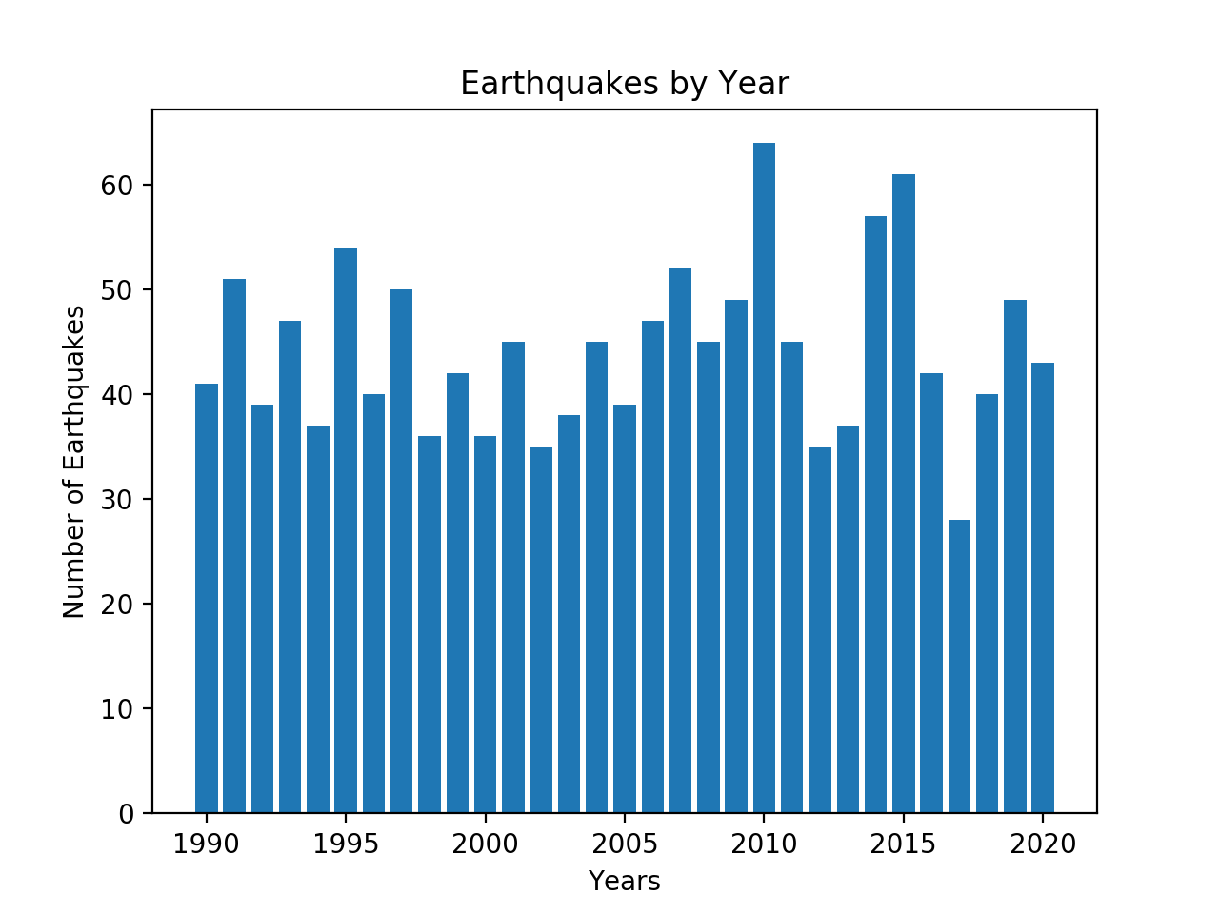
6.0 and Greater

Slide 12
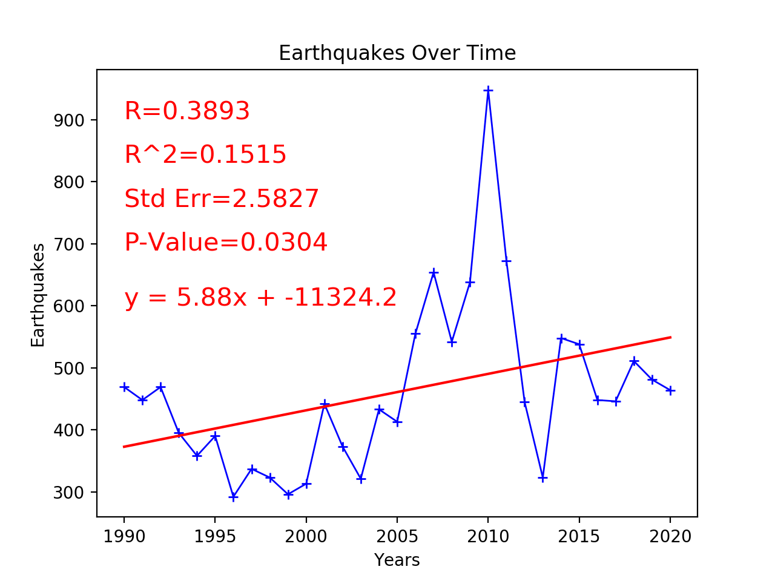
5.0 and Greater

Slide 13
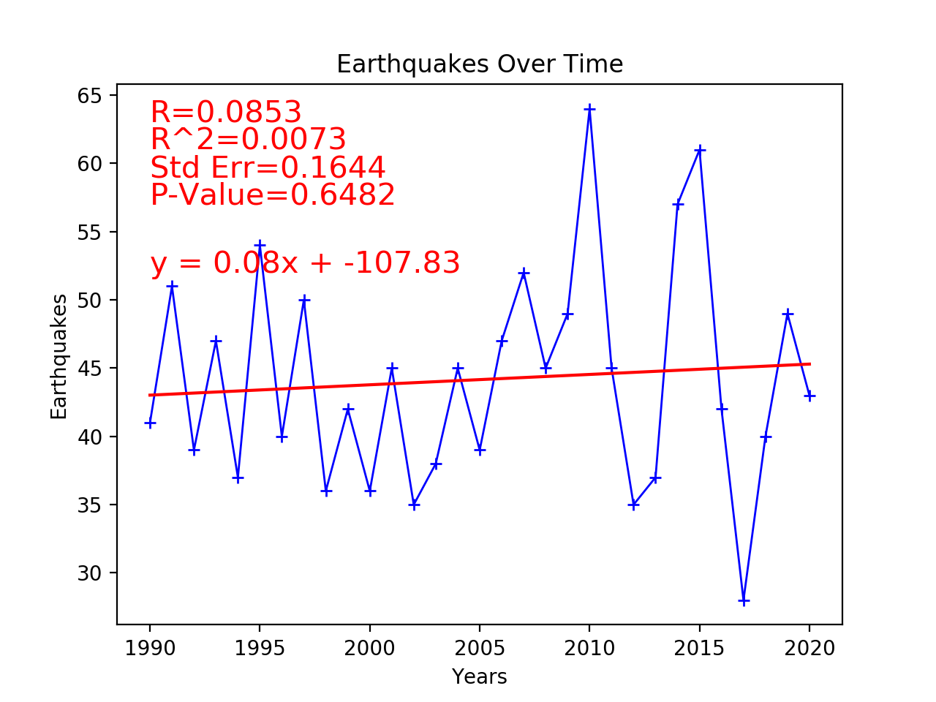
6.0 and Greater

Slide 14
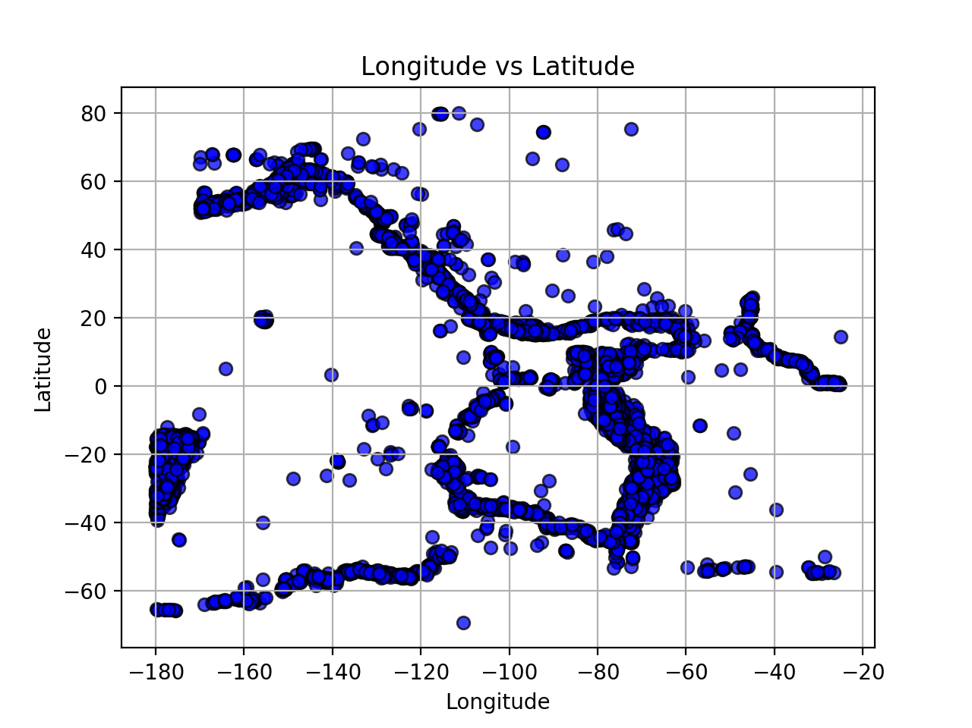
Earthquake Activity - Location

Slide 15
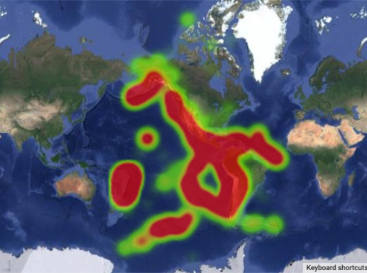
Earthquake Activity | Heat Map 1990-2021

Slide 16
Conclusions
Have Earthquakes increased in Magnitude since 1900?
No for Magnitude 5+, Slightly for Magnitude 6+
Are Earthquakes occurring more frequently since 1990?
Yes for Magnitude 5+, Slightly for Magnitude 6+
Where are Earthquakes most likely to occur?
Along the Pacific Coast of North America
Along the Pacific and North Coasts of South America
Notes:
Our research shows that Earthquakes have decreased in average magnitude since 1990, however, when only Earthquakes of Magnitude 6 or greater are accounted for there is a slight increase in Magnitude
Our research shows that Earthquakes are occurring more frequently since 1990, particularly in the 5-6 Magnitude range
Pacific Coast of North America, Pacific and North Coasts of South America is the erea where the earthquakes occur mostly.

Slide 17
Observations and Next Steps
There is a lot of volatility in the Earthquake occurrences that could be causing an apparent increase in Earthquakes
2010 could possibly be an outlier skewing the data
Research farther into the past to determine more accurate trends

Slide 18
Resources
https://earthquake.usgs.gov/fdsnws/event/1/?ref=springboard
Google Maps
Pandas
Matplotlib

Slide 19
Steps
-parameters = {latitude, longitude, Magnitude, timestamps}
-API’s call = { Alert Level (green, yellow, red, orange), Date and Time (unix), Magnitude
Magnitude Type, Location, Tsunami, coordinates (lng, lat)}
-create a Dataframe for different regions that allow to do plotting.

Slide 20
Thanks for your attention

